Slide 1
OBERT
Analyzing Omission Bias using DistilBert
100498877 - 20-08-2025

Slide 2
Proposed Framework
Data (Articles)
Data from Nexis Database and Diffbot was retrieved as articles
Preprocessed text passed through a Window Filter
Date-based filtering applied for each event
Matching techniques used to link events with articles
Articles scored and labeled as biased or unbiased based on correlation
Temporal Window Filter
Matching System
Bias Ranking

Slide 3
Background Work

Slide 4
Identifying Media Bias beyond Words: Using Automatic Identification of Persuasive Techniques for Media Bias Detection
[Rodrigo - Gine ́s et al., 2023]
Logistic Regression served as a baseline, no tuned parameters
Simple - Used for Classification Tasks
TF-IDF (Term Frequency - Inverse Document Frequency) for encoding texts
A fine-tuned DistilBERT from HuggingFace library
It learns from representative terms from the texts to capture complex patterns not manually designed features
Cascading two DistilBERT models, for multi-label classification further boosted performance
Model is used to Identify language patterns and persuasion techniques and label them
Decide any persuasion techniques involves using thresholds resulting Highest F1 score while training
Thresholds were determined using softmax function

Slide 5
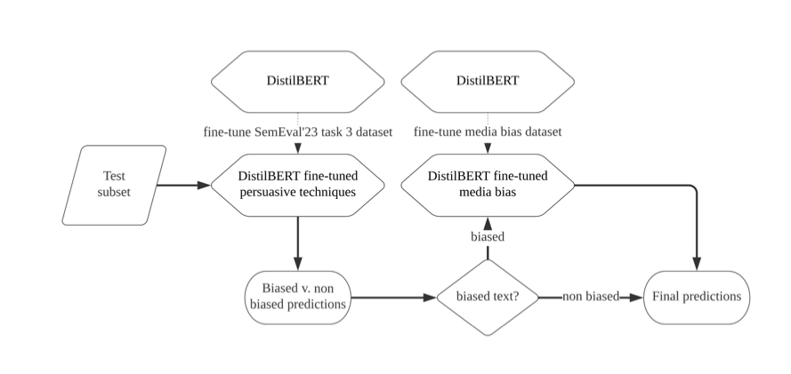

Slide 6
Model1 = trained using SemEval’23 task 3 dataset
Model2 = trained using Ukraine News dataset
The models were trained with learning rate = 5e-5 and Adam Optimizer
Experimented on News from Ukraine and other countries
Trained on Multiple Countries
Trained on Multiple Countries except Ukraine
Trained on Ukraine only
Trained on Multiple Countries and Evaluated with news from Ukraine and Vice Versa
Transformers clearly outperform Logistic Regression
Logistic regression model highly drops in efficiency when removing the lexicon with biased words
Cascade models outperforms cross country news
Train Ukraine → Test outside: +6% improvement.
Train outside → Test Ukraine: +90% improvement

Slide 7
A Domain-adaptive Pre-training Approach for Language Bias Detection in News
[Krieger et al., 2022]
Pretrain them on WNC domain, and perform fine tuning for media bias classification using BABE.
WNC - Contents from Wikipedia that go against the Neutral POV
Improves word representations by adapting to both biased and non-biased content
Transformer model like BERT: learning Bidirectional word representations on unlabelled text optimizing an unsupervised learning task based on (Masked Language Modelling and Next Sentence Prediction)
Training time took over 5 hours using Tesla P100-PCIE GPU with 16GB RAM
Fine Tuning ~ 15 minutes ~ Tesla K80 GPU with 12 GB RAM

Slide 8
Tests whether domain-adaptive (WNC) pre-trained model tuned with BABE improves sentence classification compared to pre trained model fine-tuning on BABE alone
McNemar’s test - non parametric approach (no distribution) is done for comparison in a 2x2 contingency table
H0 = Both models output the correct labels for same instances from test set
H1 = Each model differ in terms of their agreement on items from test set
All Domain-Adapted models outperform baseline and distantly supervised models.
DA-BERT F1 = 0.809 → outperform baselines by 2%; DA-BERT only +0.5% better than BERT.
Distilbert shows better performance with pre training than larger models like BERT - already powerful and trained with rich vocabulary

Slide 9
DistilBERT, a distilled version of BERT: smaller, faster, cheaper and lighter
[Sanh et al., 2020]
Knowledge Distillation: Compression of BERT model (larger model) to DistilBERT (compact model)
Objective is to minimize cross-entropy between predicted distribution and one-hot empirical distribution of train labels (find high probability for correct labels and near - zero probabilities on others)
Trained over distillation loss - soft target probabilities
Eg: Cat = 1, Dog = 0, Horse = 0 (Hard Targets/Absolute probabilities)
Cat = 0.85, Dog = 0.10, Horse = 0.05 (Soft targets)
DistilBert has token embeddings removed, number of layers reduced by 2. Optimized operations in linear algebra frameworks in Transformer arch.
Starting DistilBERT from scratch (random weights), they copy weights from the BERT to give the student a head start

Slide 10
Distilled on very large batches leveraging gradient accumulation using dynamic masking
Trained on 8 16GB V100 GPUs for approximately 90 hours
Evaluate DistilBERT on the GLUE (General Language Understanding Evaluation) benchmark (collection of 9 datasets) by fine-tuning (9) individually
Baseline: ELMo -> Encoder with 2 BiLSTMs and DistilBERT improves over baseline
Only shows 0.6% drop in (test accuracy)evaluation against BERT having 40% fewer parameters
DistilBERT is 71% faster than BERT on a question answering model on a mobile, size = 207MB
Effectiveness of distillation may vary depending on the task
Reliance on distillation during pre-training suggests that the model's success depends on the quality

Slide 11
Dataset Extraction
(Nexis)

Slide 12
NEXIS DATABASE
Nexis data extracted using Selenium Wire
Tried PULL & REQUESTS - Pull & Requests approach: not feasible—login issues caused browser crashes
Tried Selenium - Same as Selenium wire, wasn’t flexible enough to extract the words out from HTML/JS elements, only a few articles at a time → needed frequent reruns
Diffbot keywords using KeyBERT (easier) used to retrieve additional articles (batch processing), 500 per search, due to time limit, 15 keywords per row.
Automation reduced manual effort & increased reproducibility
Outlier dates exist, but most articles from 2020–2022

Slide 13

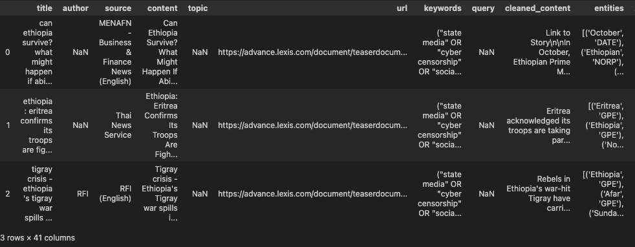
Features

Slide 14


Slide 15


Slide 16


Slide 17
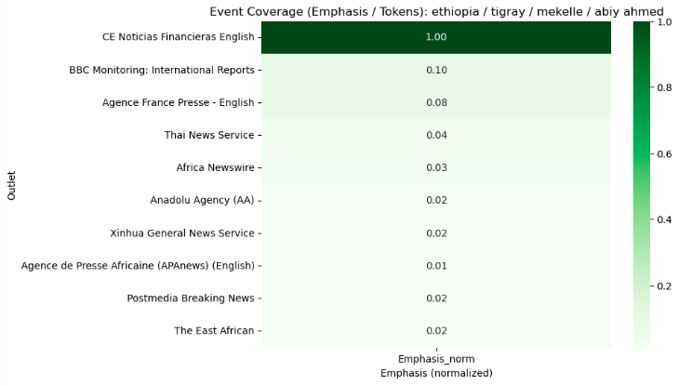
Source

Slide 18
Actual Events

Slide 19
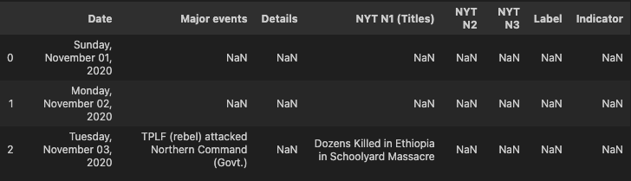

Slide 20
Diffbot Dataset

Slide 21

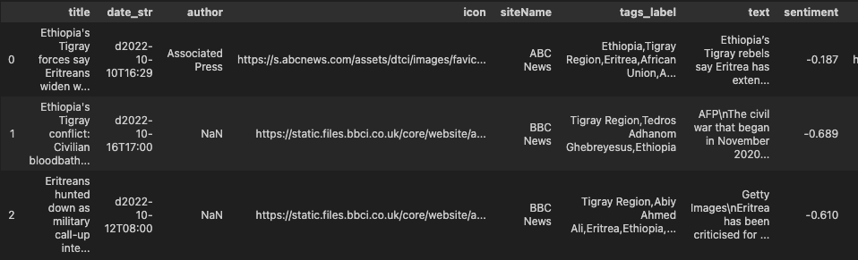
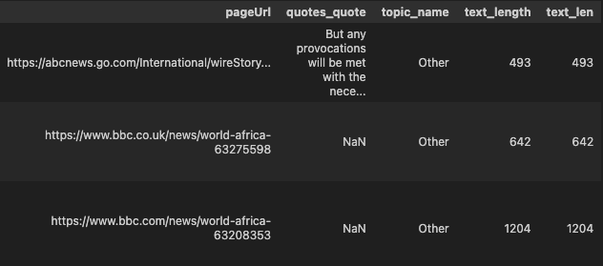
Features:

Slide 22
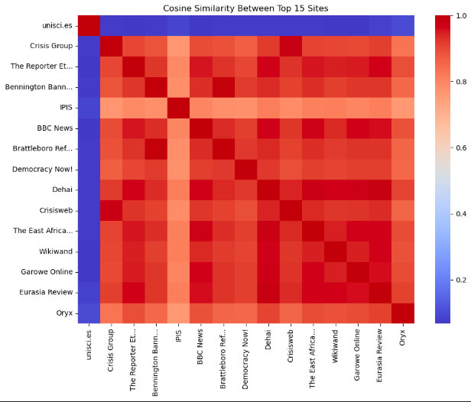
Similarity Across Sources

Slide 23
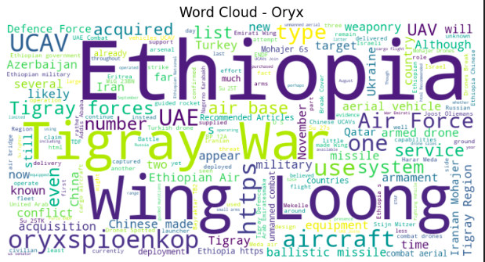

Slide 24


Slide 25
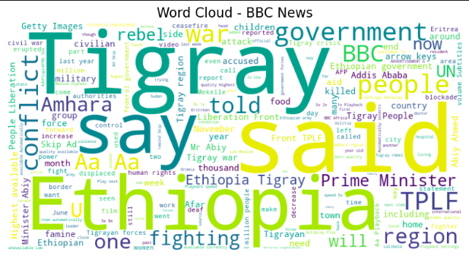

Slide 26
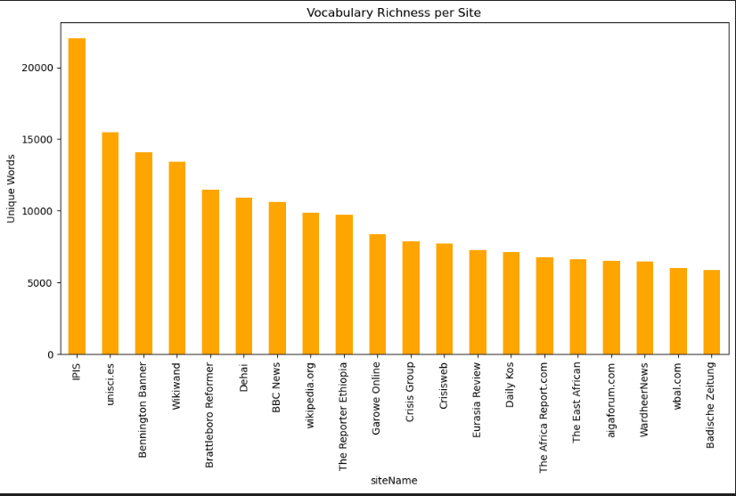

Slide 27
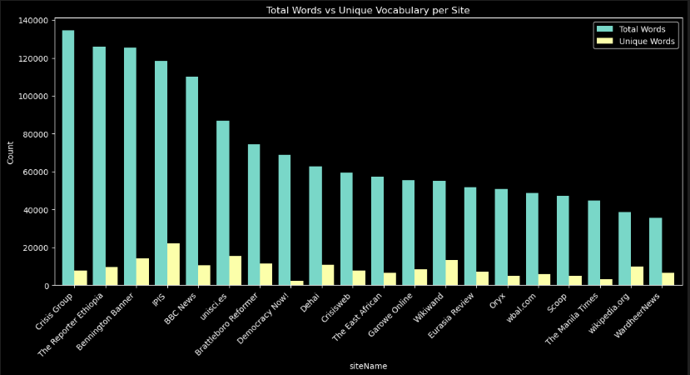

Slide 28
Diffbot and Nexis Comparison

Slide 29
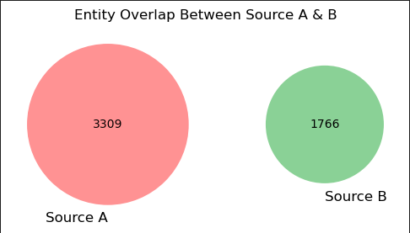
Df1 = Nexis Database
Df2 = Diffbot Database
Entity Count

Slide 30
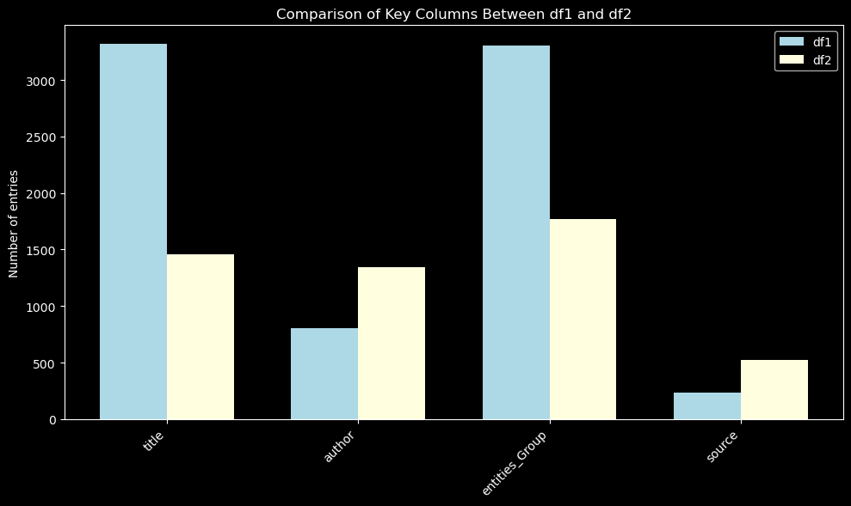

Slide 31
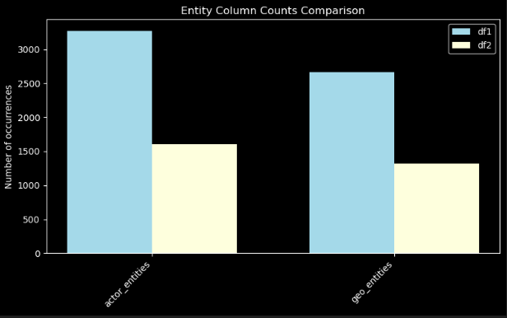

Slide 32
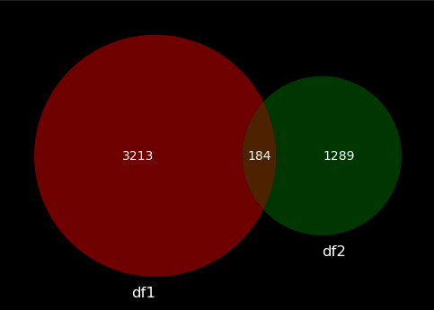
Based on Cosine Similarity Score

Slide 33
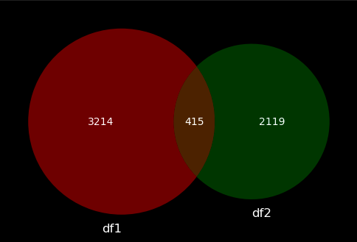

Slide 34
Data Preprocessing

Slide 35
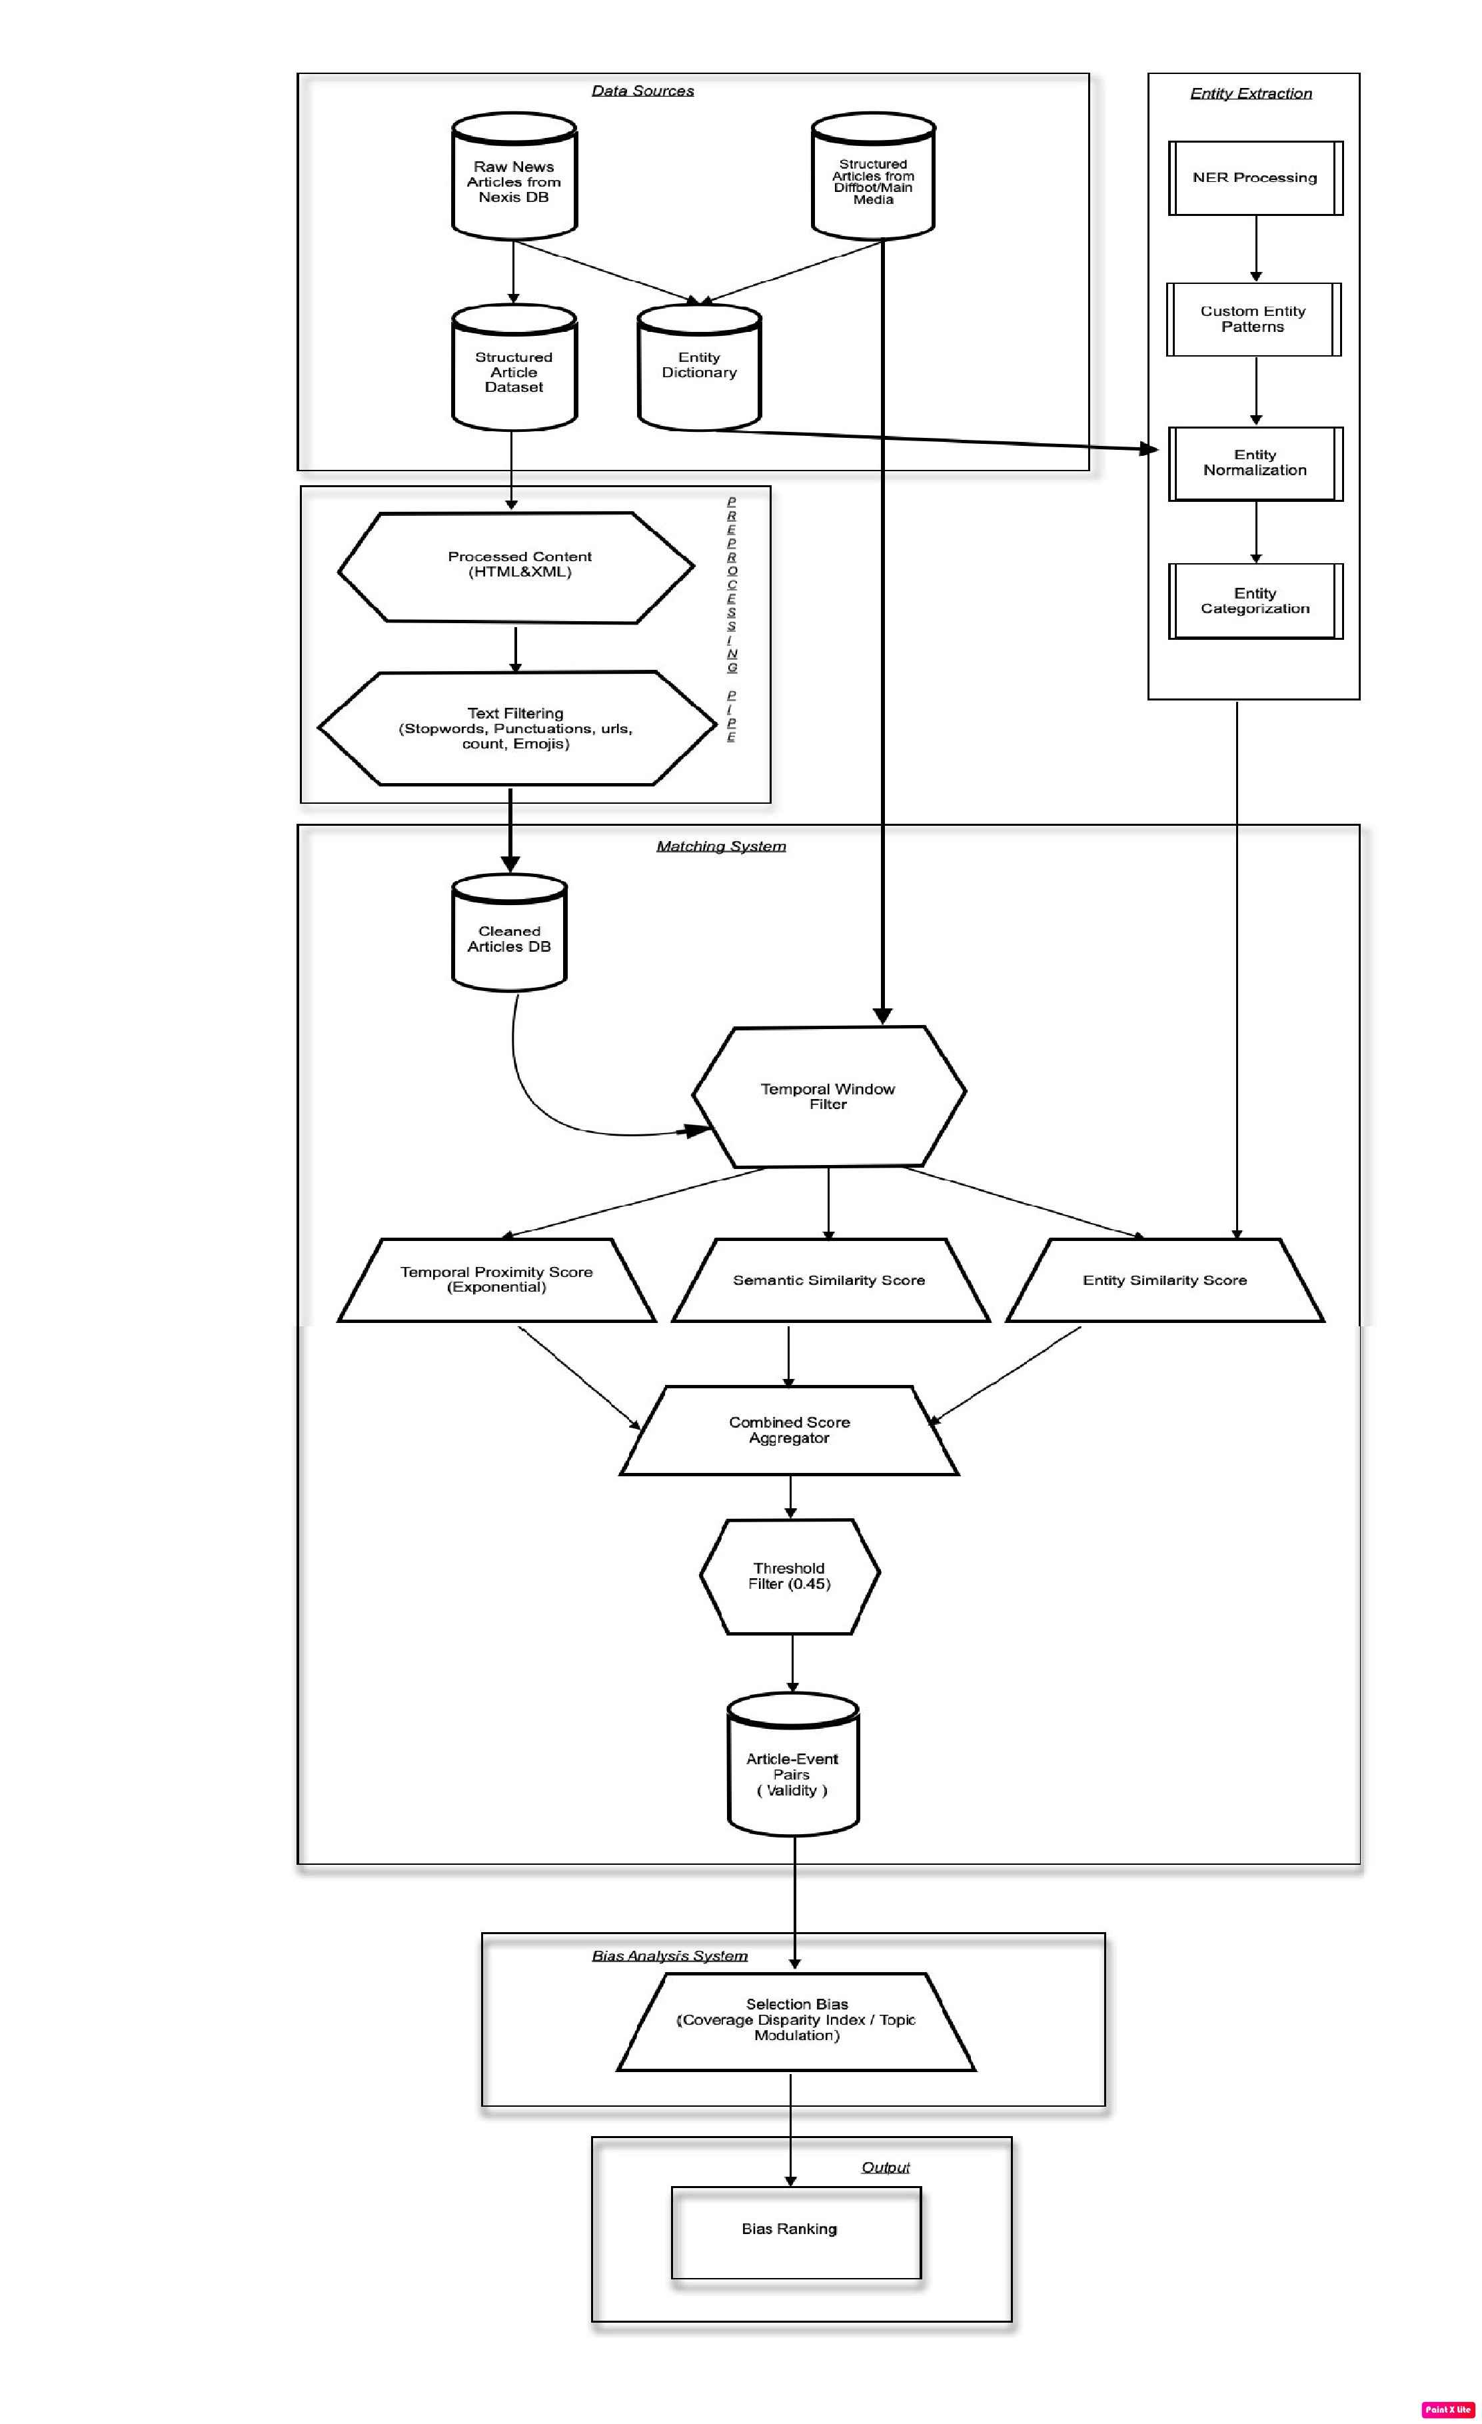

Slide 36
Cleaned the article content by removing everything before the <Body> tag.
en_core_web_sm NLP model, which allowed me to identify named entities such as people, places, organizations, and dates. Encoded entities using ‘all-MiniLM-L6-v2’.
Entities gathered are normalized using more precise terms via Clustering (Agglomerative) - Fuzzy Matching - rapidfuzz. Consider the most_common(1)[0][0] term from the group and process.extractOne
Extracted key phrases and actions. Key phrases, chunks of text, while actions were identified by looking specifically at verbs in the part-of-speech tagging.
Formatted all extracted dates into a consistent format, using re package
— for example, converting November 7, 2022 into 7-11-2022.

Slide 37
Make the text case - insensitive
Remove the hyphenated texts, hyphenated words, email, emojis and normalize the accents with their defined letter
Create a lookup list with all the stopwords + already built in stopwords words in English’ also the punctuations and certain sentences like ads, using an re package.
Through a pipeline combine all these functions so that it is completed within one step

Slide 38
Time Window Filter

Slide 39
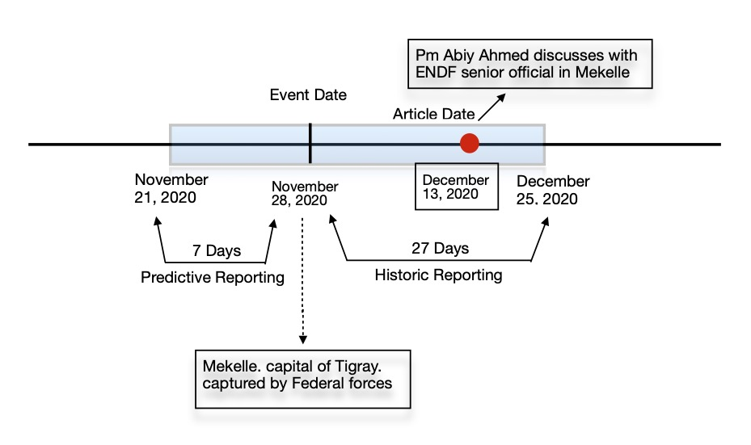
Reduce search space by focusing on articles most relevant to each event.
Collect articles around event dates within a fixed time window.
27 Days Prior → Historic Information (context, buildup, background)
7 Days After → Predictive Information (coverage, forecasts, outcomes)

Slide 40
Combined Weighted Score

Slide 41
Time window reduces the search space but is not enough for precise categorization.
Multi-dimensional approach - Articles are evaluated on different dimensions.
Entity Similarity Score
Measures overlap between article entities and event entities
Captures who/what the article is really about
Semantic Similarity Score
Compares article and event titles
Checks term overlap and hidden linguistic patterns
Validates the thematic connection between sources
Temporal Score
Measures the gap between event date and article publish date
Quantifies closeness of reporting to the actual event

Slide 43
Entity Similarity Score

Slide 44


Match articles with events based on shared actors and locations
The entities retrieved earlier are considered for this purpose. With the help of their labels from doc.ents we opted the Person, Organization and Nationality/Religion/Politics as actors along with Geopolitical and Location as geographic entities
Computation of entity score was done using a methodology called Jaccard Similarity
After computing that, we find the averaged sum of the two entities as a measure of scaling

Slide 45


Slide 46
Semantic Similarity Score

Slide 47
3 ways was applied to find the Semantic Similarity Score for their titles
Cosine Similarity in Document level encoding & Sentence Level
Story Chain (graphical representation)
Cosine Similarity using Faiss Index
Applied Cosine Sim function on Content but slow to calculate

Slide 48
Used SentenceTransformer (BAAI/bge-base-en-v1.5) to generate embeddings.
Created event embeddings (titles → vectors) for fast lookup
Articles were broken into sentences, embedded, and averaged to get one vector per article.
Only compared each article against its time-window-matched events (not all events → reduces search space by filtering).
Computed Cosine Similarity between article & event embeddings.

Slide 49
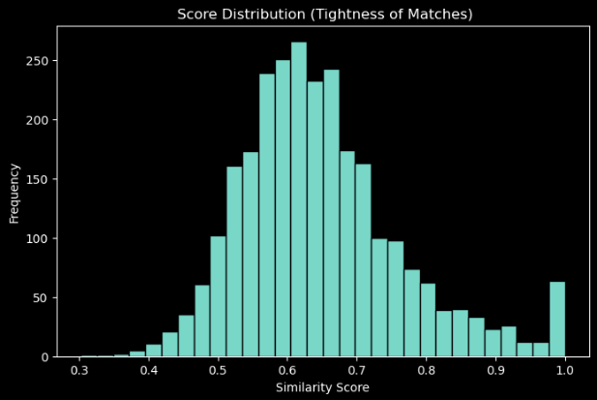

Slide 50
Facebook AI’s FAISS library is optimized for fast vector similarity search.
Uses inner product search after normalization (equivalent to cosine similarity).
Very aggressive working for small datasets
Normalize vectors (faiss.normalize_L2) → required for cosine similarity
Build FAISS index (IndexFlatIP) for efficient lookups. Mapped with event embeddings
FAISS retrieves the closest event match for each article title based on max (probability score). But the default similarity threshold (~0.4) was too strict, allowing little margin for minor matches.

Slide 51
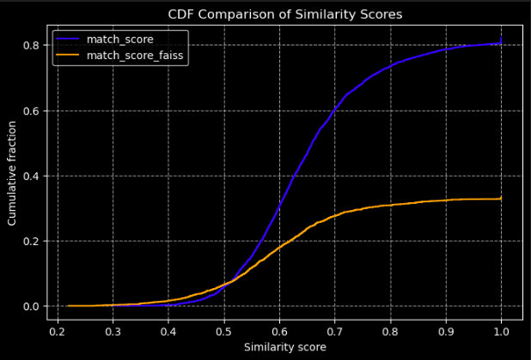

Slide 52
Temporal Proximity Score

Slide 53
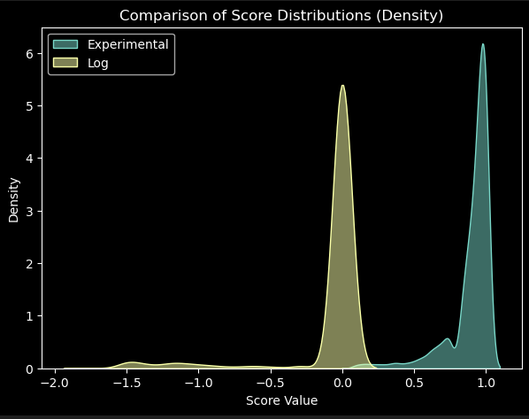

Assess how closely an article is related to an event based on dates.
Two scoring methods: Exponential Decay & Logarithmic Decay.
Δ = days between event and publishing date
α = scaling factor ( predictive = 0.8, historical = 1.0
Score decreases exponentially as article-event gap increases.

Slide 54
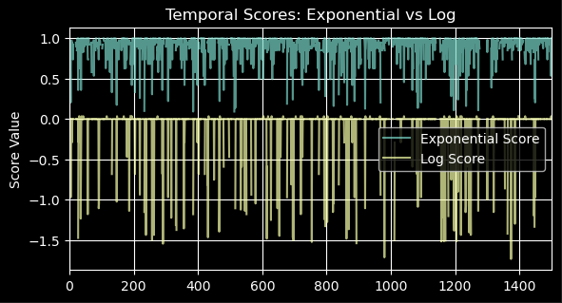
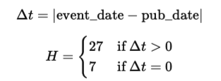
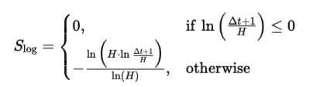
Exponential decay scores are gradual, whereas log scores are abrupt

Slide 55
Finally, we assign target variables depending on the threshold = 0.5 and labels assigned to diffbot & Nexis Data
Combined_score >= 0.5 & Valid -> Valid
Combined_score < 0.5 & Invalid -> Invalid

Slide 56
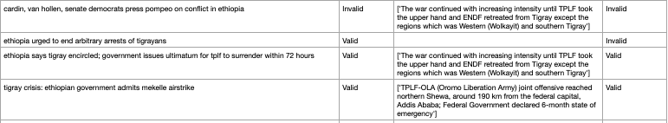
Labels
Diffbot & Nexis
Labels
(D & N) & Actual Events
Title
Major Events

Slide 57
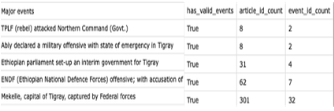

Slide 58
In addition, in order to merge the two datasets
We consider the article IDs, match Labels on both the datasets and the score
Depending on the scores that is higher than the threshold = 0.45
And Match labels that are Valid
We assign the Valid to the overall row/dataset
Eg: Final_Score >= 0.45 && Match_Labels == Valid => Valid else Invalid
Final Score: Nexis Scores measured against Actual Events
Match_Labels: Nexis Scores assigned against Diffbot Dataset

Slide 59
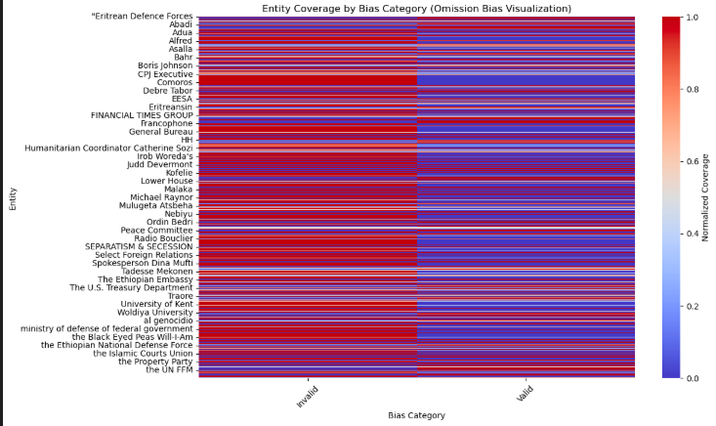
Covered
Uncovered

Slide 60
Bias Detection System

Slide 61
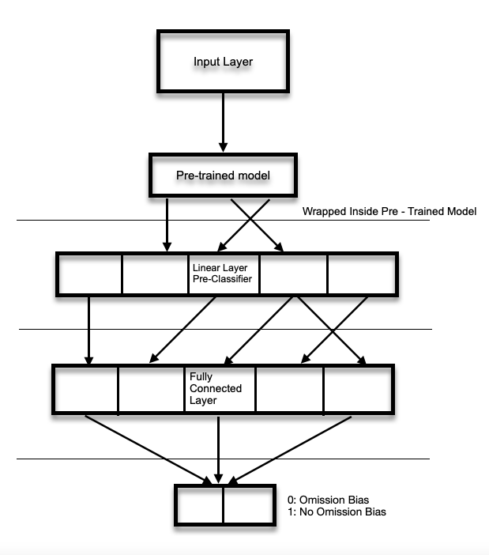

Slide 62
Inputs: Article content + entities + actions + key phrases
Labels: MATCH_LABELS_ENCODED (binary classes)
Architecture: DistilBERT + linear head (2 classes)
Loss Function: Weighted Cross-Entropy (to handle imbalance)
Custom BiasDataset with tokenization (max length 512)
Padding + batching via HuggingFace DataCollatorWithPadding (Epochs: 4)
Optimizer: AdamW (lr = 5e-5)
Loss weighting applied using sklearn compute_class_weights : Balanced
Training loop with backprop + gradient updates

Slide 63
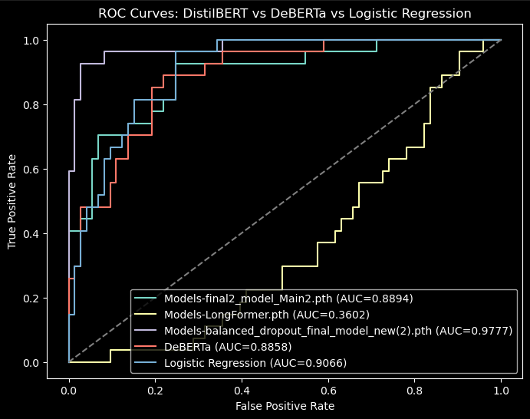

Slide 64
2 types of Main Dataset was applied :
Balanced & Unbalanced
Unbalanced & Balanced - Overfitting with only minor adjustments
Balancing Text Dataset, risks overfitting rather than helping the model pick up new patterns. (0.99 - Accuracy); With Dropout (0.97 - Accuracy)
Unbalanced Dataset (0.88 - Accuracy)

Slide 65
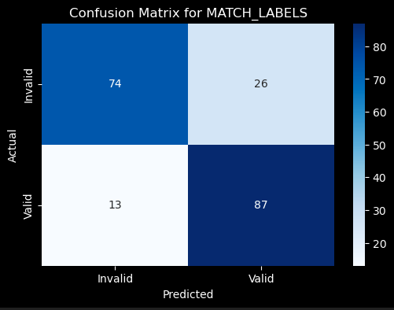
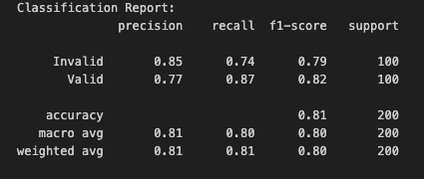
Other Alternatives Considered:
DeBERTa

Slide 66
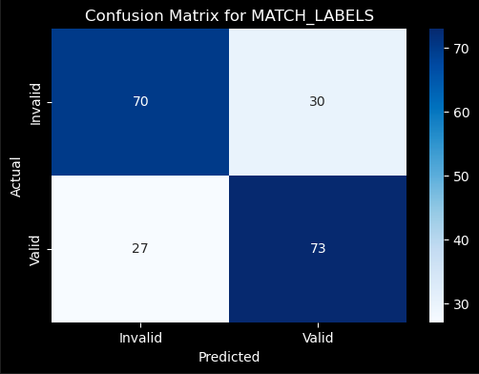
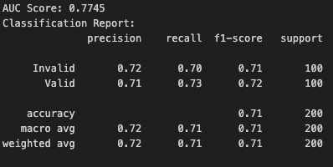
BERT

Slide 67
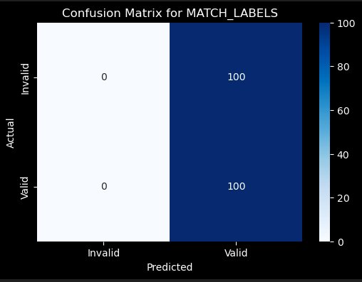
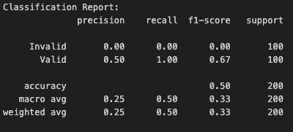
Longformer

Slide 68
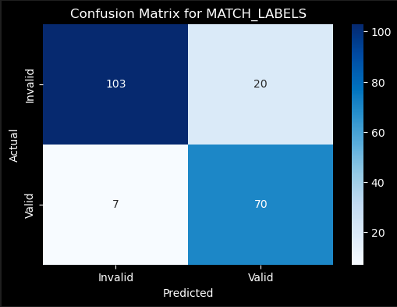
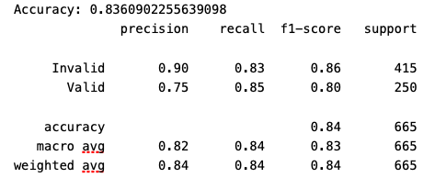
Logistic Regression

Slide 69
Limitation

Slide 70
Larger models (Longformer, DeBERTa) need bigger datasets to train according to their capacity
Small dataset → limits performance gains, increases overfitting risk
Longer sequences (full articles) caused processing inefficiencies due to computational limits
Restricted scalability
Small batch size (5) → slower training (CPU-only setup)
Used Google Colab for Longformer → limited GPU usage time.
512-token limit of DistilBERT truncated long articles - lost context
Applied chunking (450 tokens + 50 overlap) → increased training time

Slide 71
Future Works

Slide 72
Cascade this model into an actual Sentimental Analysis architecture
Build a larger, balanced dataset → improve representation & generalization.
Use GPU or distributed training
Enable better full-article matching (higher precision + recall).
Overcome token-limit and capture deep contextual patterns for bias detection
Optional: Cascade a Decoder (Generative Pretrained Transformer) to automatically retrieve a reference article from a reliable source .i.e. Nexis Database (here)

Slide 73
Thank you

